Slide 1
NBA Scouting Analysis
Presented By: Max Fishman, Cory Selzer, Dulce Silva, Shail Desai, Sebastian Alonso

Slide 2


Who are we and what is our purpose?
NOTE:
To change images on this slide, select a picture and delete it. Then click the Insert Picture icon
in the placeholder to insert your own image.
Analytics plays such a vital role in major sports organizations.
Our goal is to craft comprehensive scouting reports that empower our players with a tactical advantage, fostering a deep understanding of our adversaries' playing styles and tendencies. Through the fusion of basketball expertise and data science, we strive to optimize player matchups, refine game strategies, and ultimately enhance our team's competitive edge.
Additionally, we will use Machine Learning to predict a player’s future scoring output in a game based on past performance. This will help teams prepare for their future opponents.

Slide 3
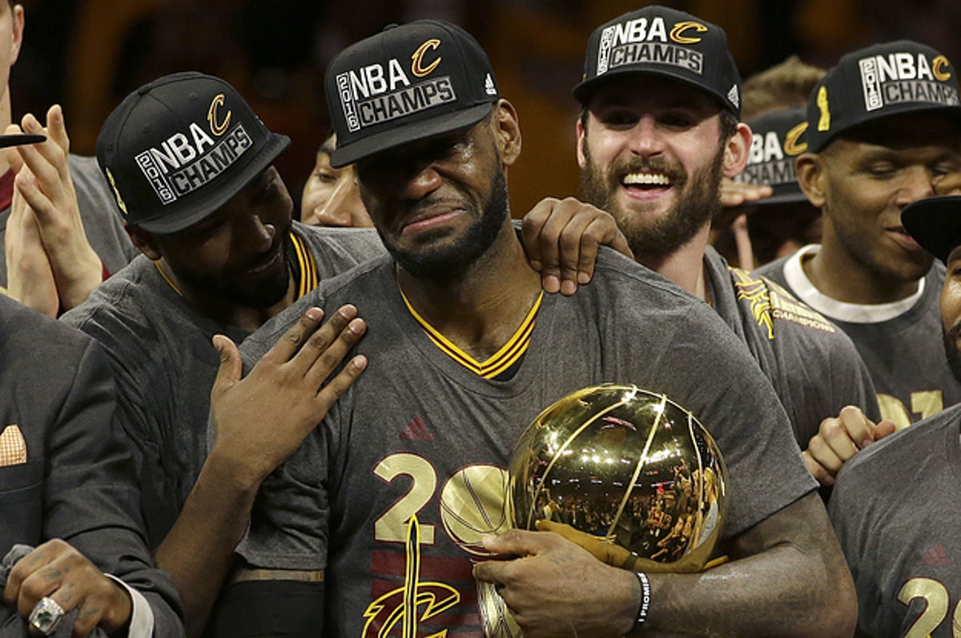
Project Goal
Our goal is to provide teams with prior performance data that can give insight into upcoming matchups and player performance.
We currently have a dashboard that includes statistics on all teams in the NBA including Roster options for each team that provide team/player statistics
This data will provide NBA organizations with real insight into future opponents.

Slide 4
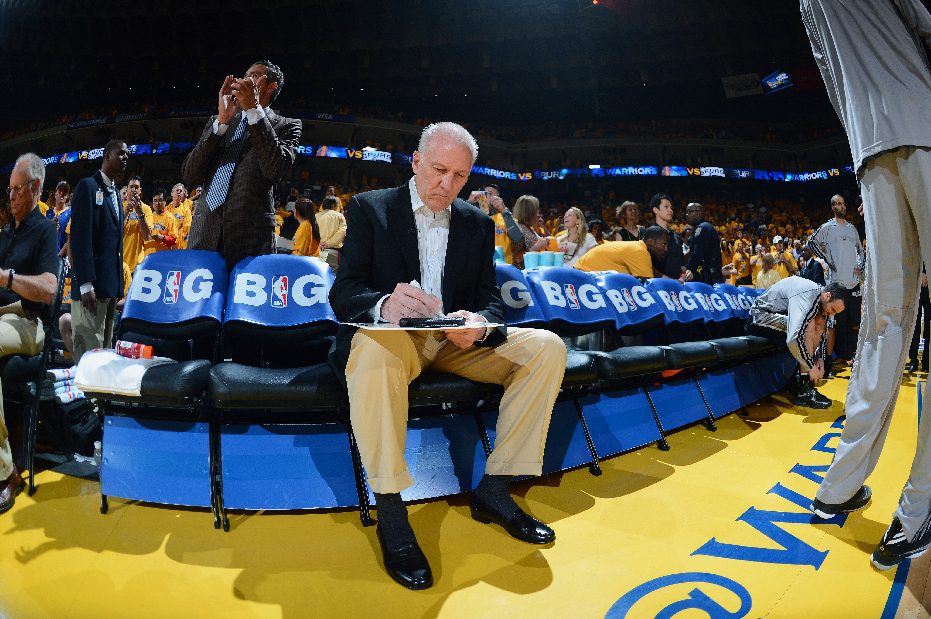
When and why is this important?
Through the analysis of extensive datasets, teams can identify player strengths and weaknesses, optimize game strategies, and make informed decisions on player recruitment, trades, and game-time rotations.
This data-driven approach not only enhances a team's competitive edge but also enables coaches and management to adapt to evolving trends in the fast-paced and highly competitive landscape of professional basketball.
Furthering the analysis of the datasets, NBA gamblers can use our Machine Learning Model to predict how many points a player is going to score in a specific game in the future.

Slide 5
How?
Our approach to the code:
We used the NBA_API Python package to gather historical data for both teams and players.
These datasets include general Roster information, past statistical performances and more.
These datasets were cleaned and then exported to CSVs.
Finally, we used one of the player datasets to incorporate Machine Learning to predict future scoring production.
Our approach to visualization:
We used our cleaned and exported CSVs to create dynamic team and player scouting analysis visualizations in Tableau.
We added a new folder to Shapes to help improve the look of the Roster worksheet.
The worksheets were then added to Dashboards and Stories.

Slide 6
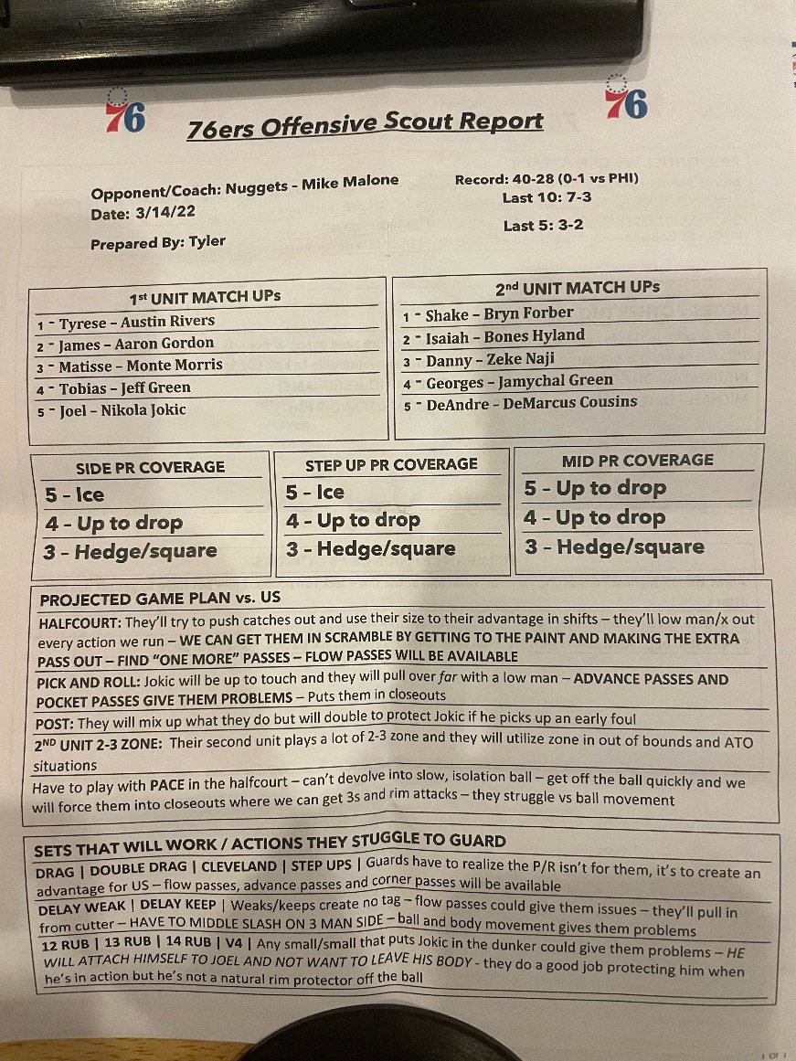
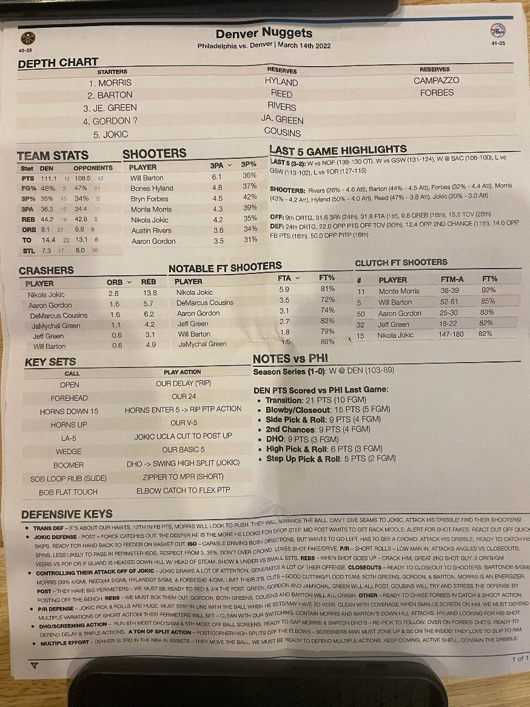
Scouting Report Examples

Slide 7
Let’s get into the Data

Slide 8
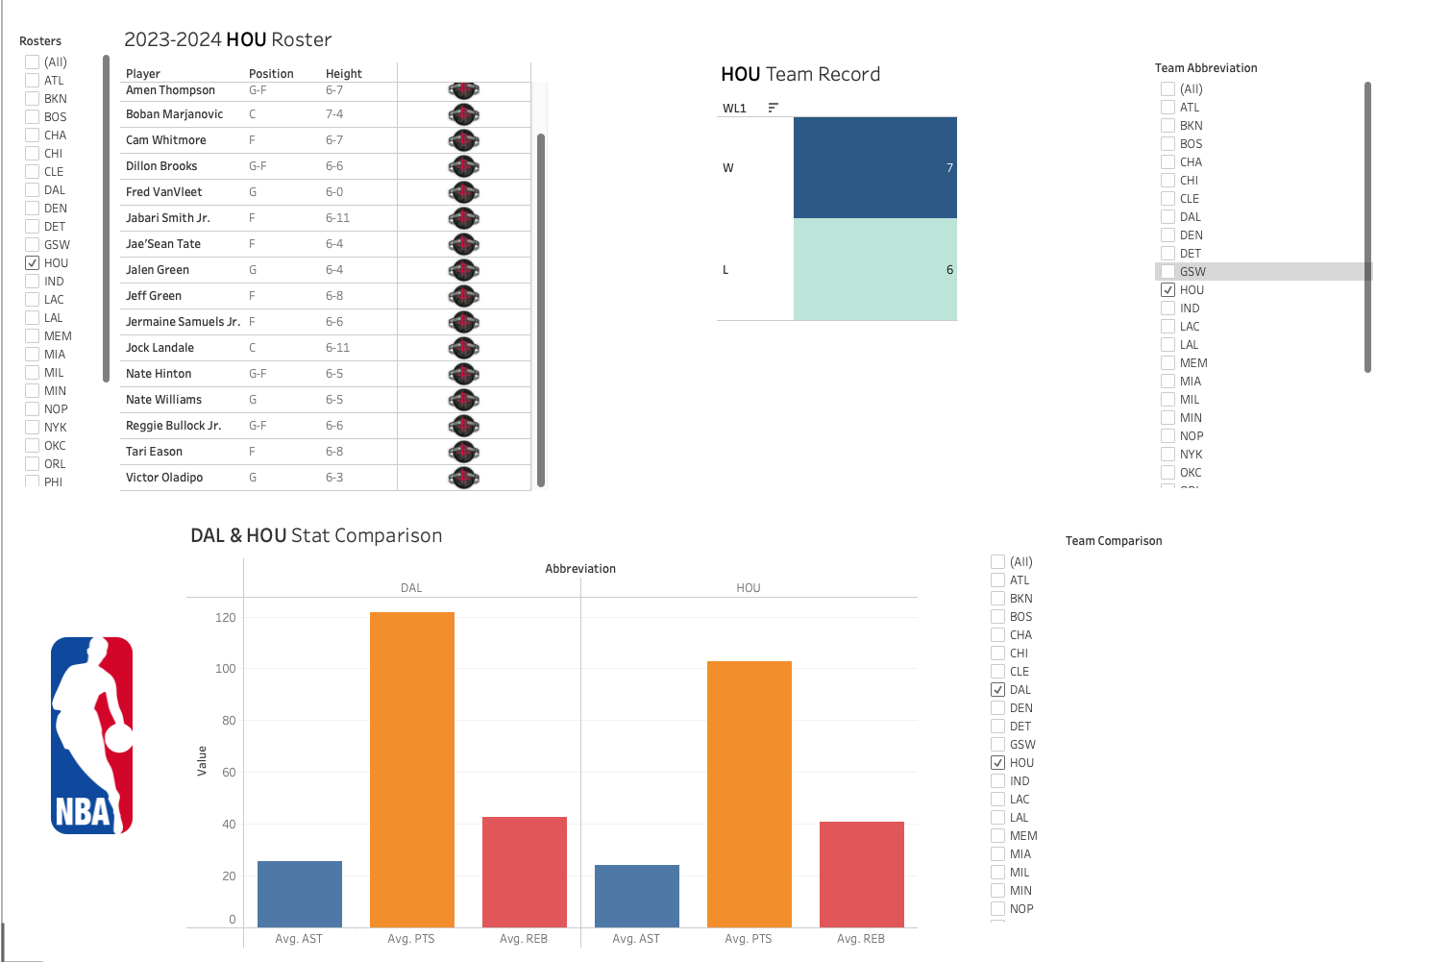
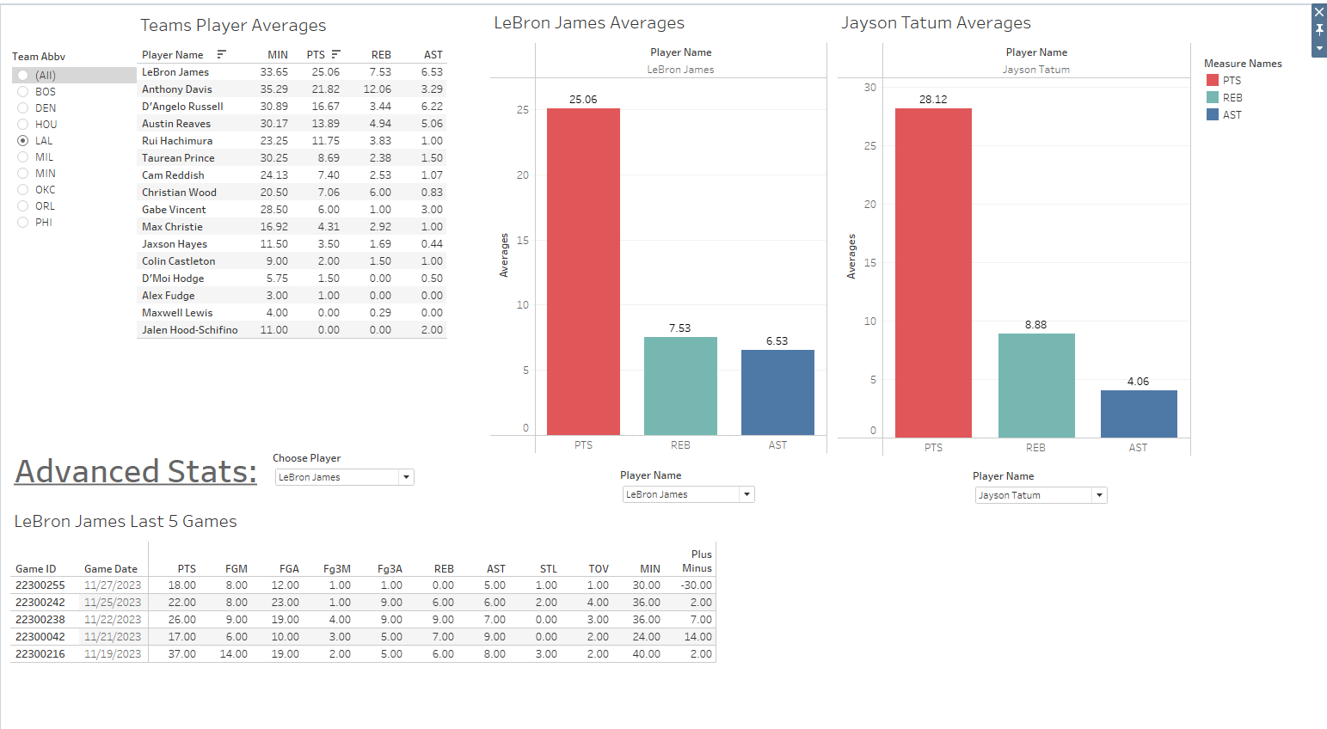
Visualization
The Team Dashboard provides insight into general team information and data for the current season.
The Player Dashboard provides insight into statistical player data for the current season.

Slide 9
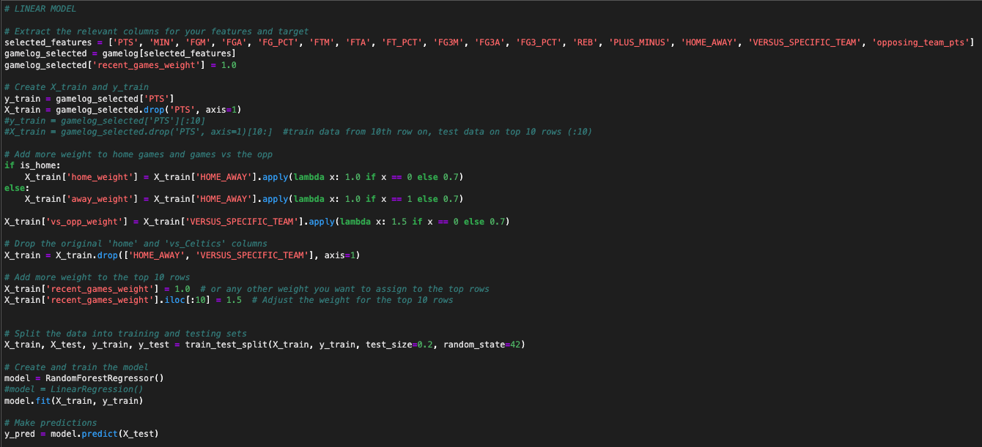
Machine Learning in Sports Analytics
Analytics (and within that, Machine Learning) have become an increasingly important sector of sports organizations recently, as team operations are focused on improving their efficiency and accurately predicting what will happen in the future.

Slide 10

Developmental Issues
Time: More time would have enabled our group to dig deeper into the statistical analysis, leading to a stronger ML model as well as more detailed scouting reports.
Machine Learning Improvement: Use ML to make predictions based on team statistics, helping the coaching staff prepare for their future opponents.
Maximum API Calls: We hit our limit on API calls to the NBA website quickly.
Tableau Features: We wanted to make our sheets and dashboards look more visually appealing.

Slide 11

Moving Forward
There are many other ways in which we can improve our products but three clear improvements to be made:
Expand the basic statistical analysis to include more advanced statistics, such as Net Rating, VORP, Box Plus—Minus and others.
Add more Machine Learning models to predict future opponent performance.
Alter the Machine Learning player prediction model to better account for recency bias.
Use Tableau to improve the appearance and formatting of our visualizations.

Slide 12

Thank You!

